Slide 1




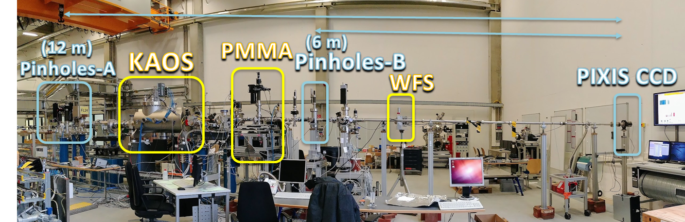
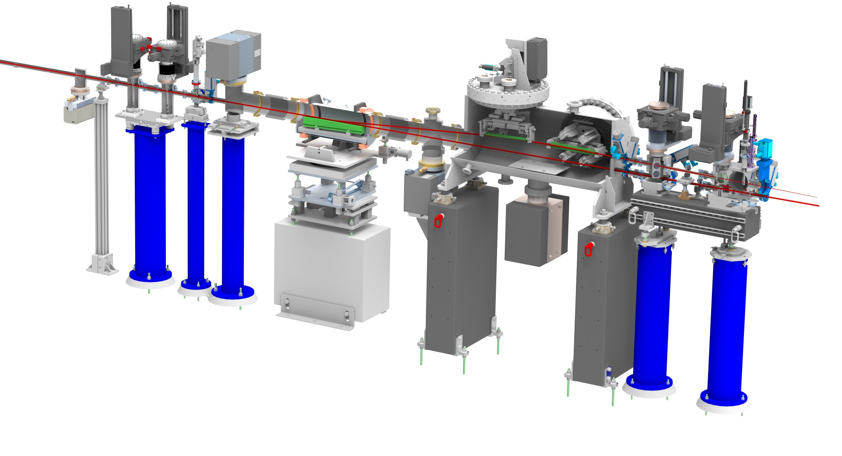
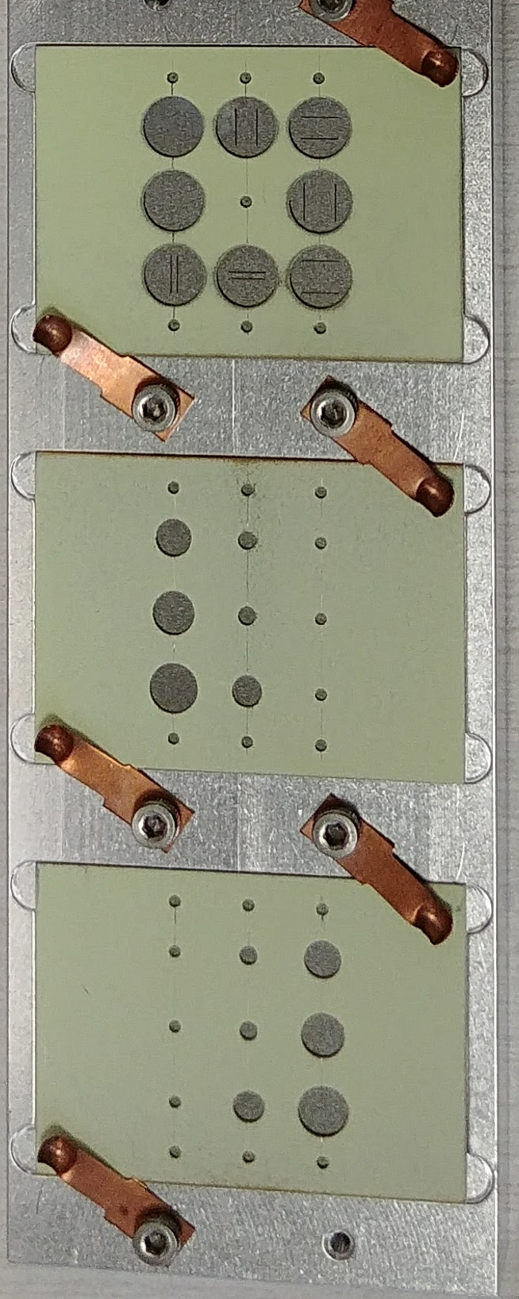
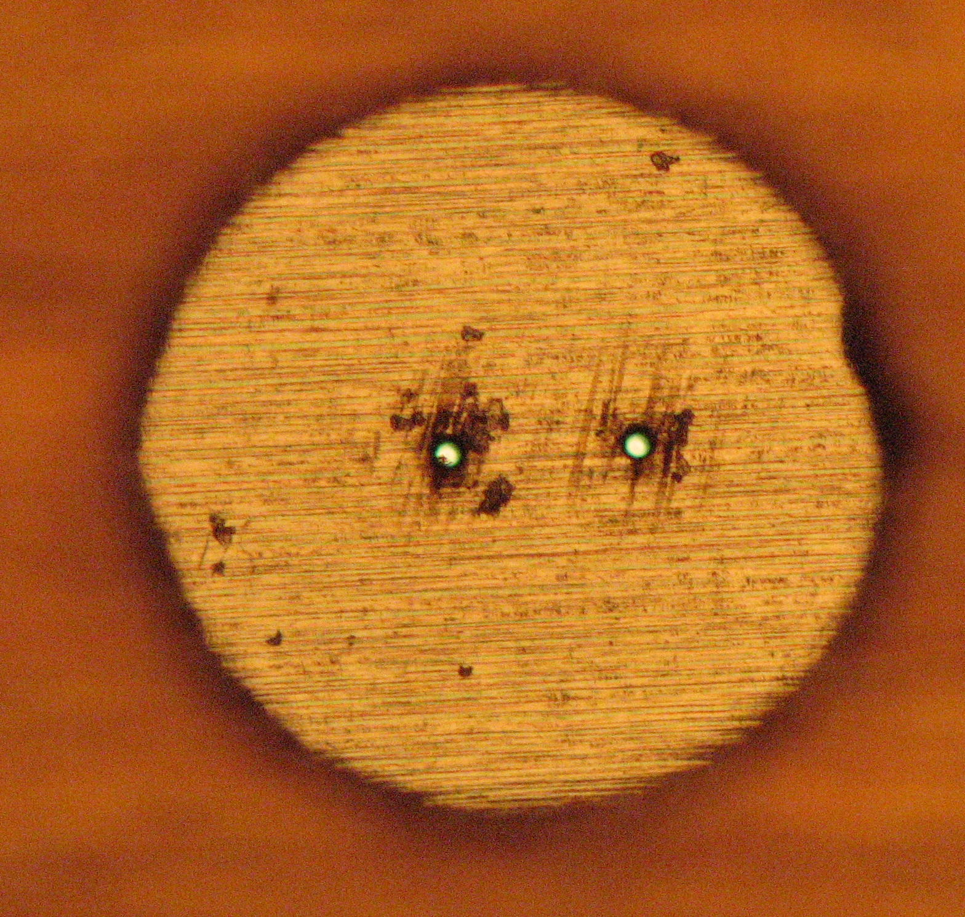
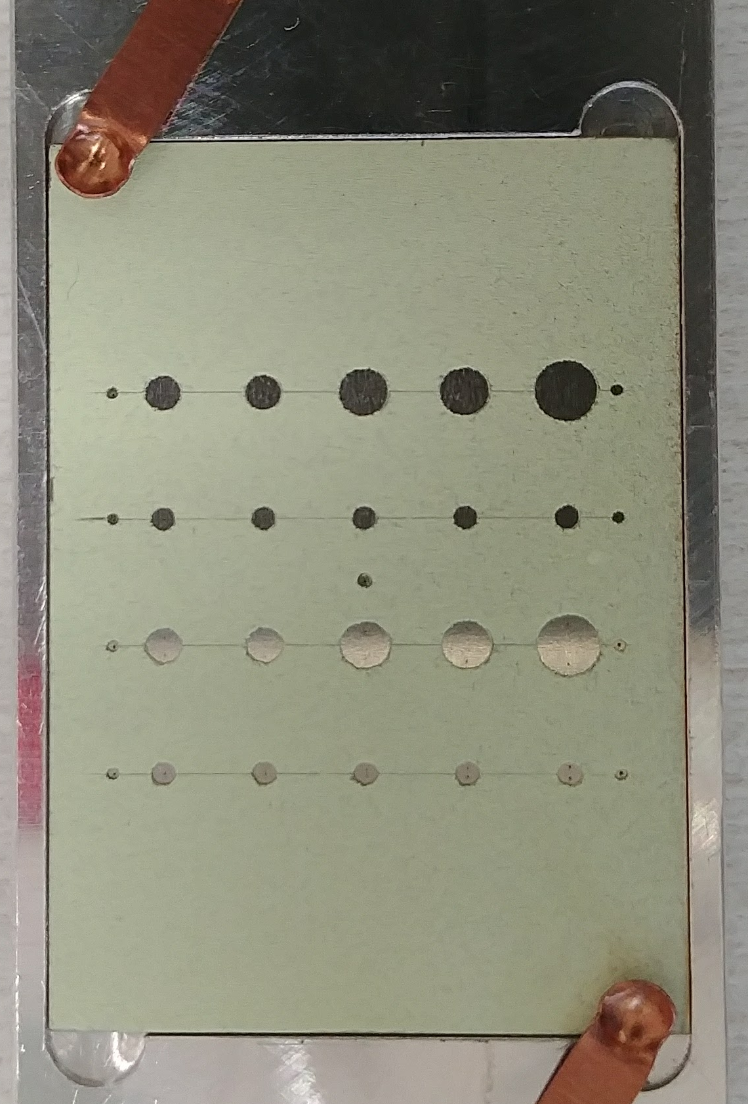
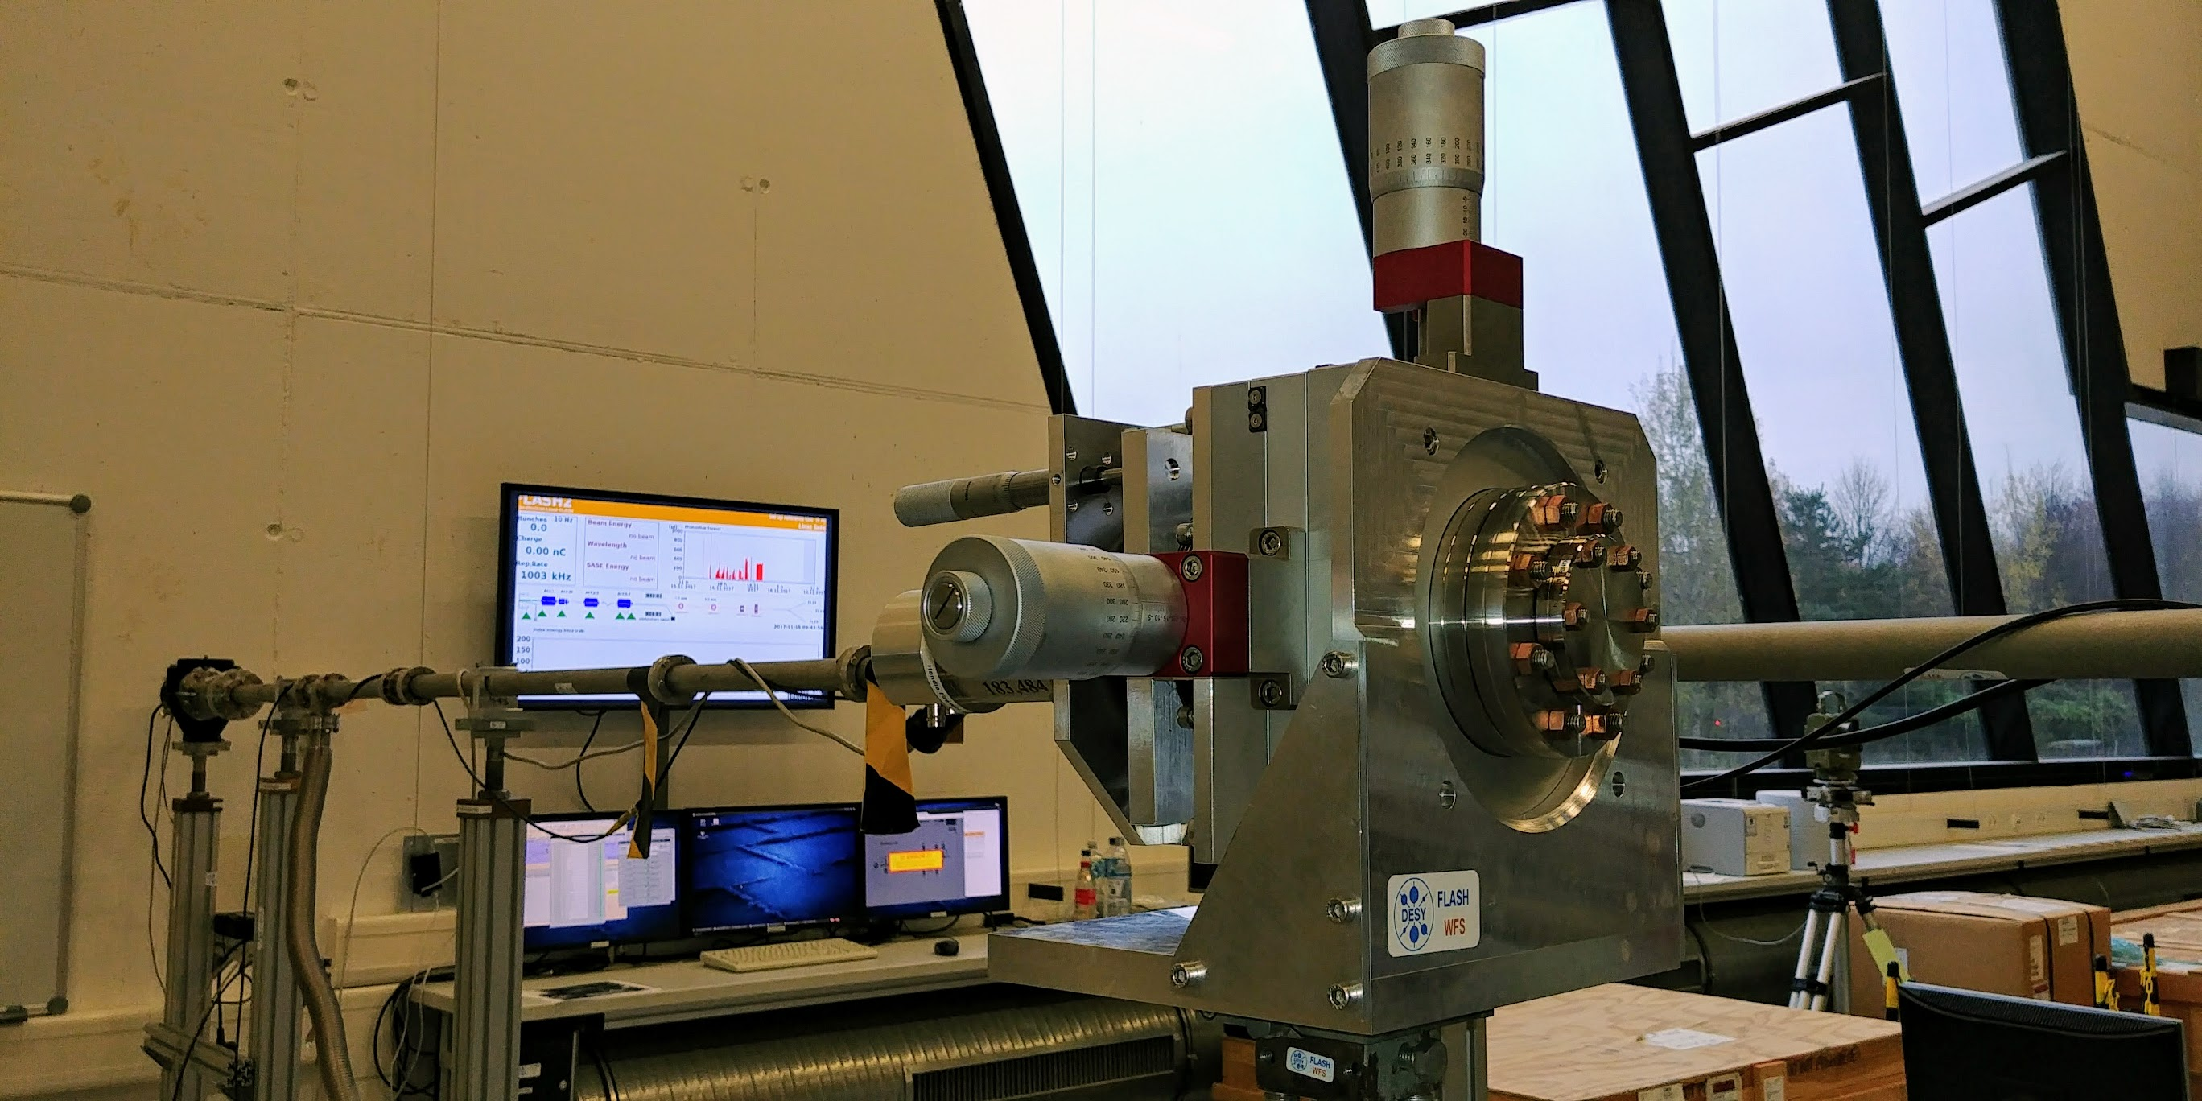
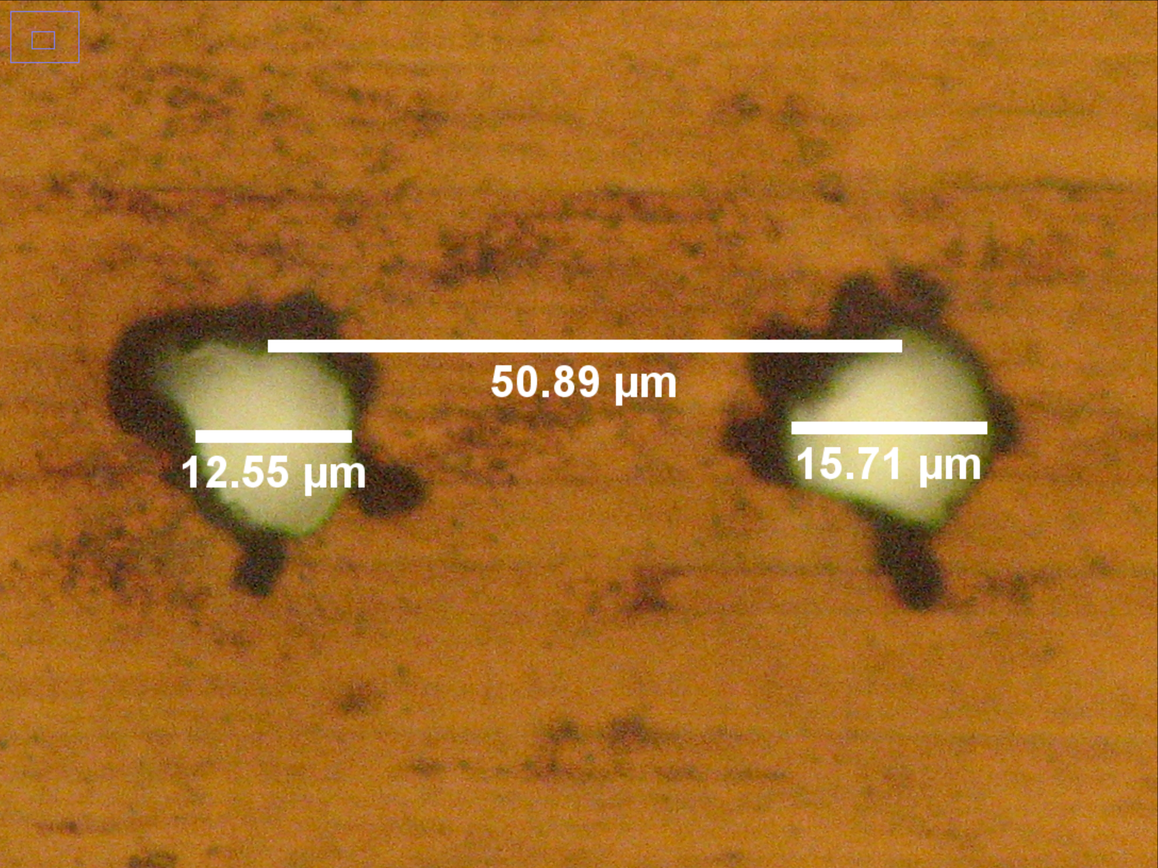
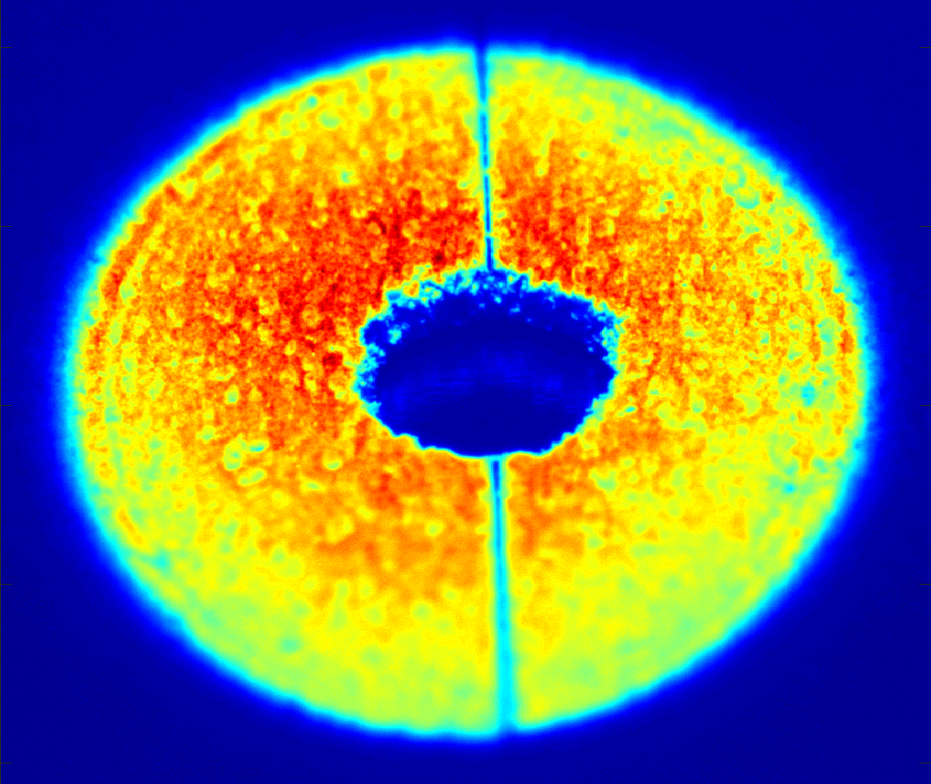
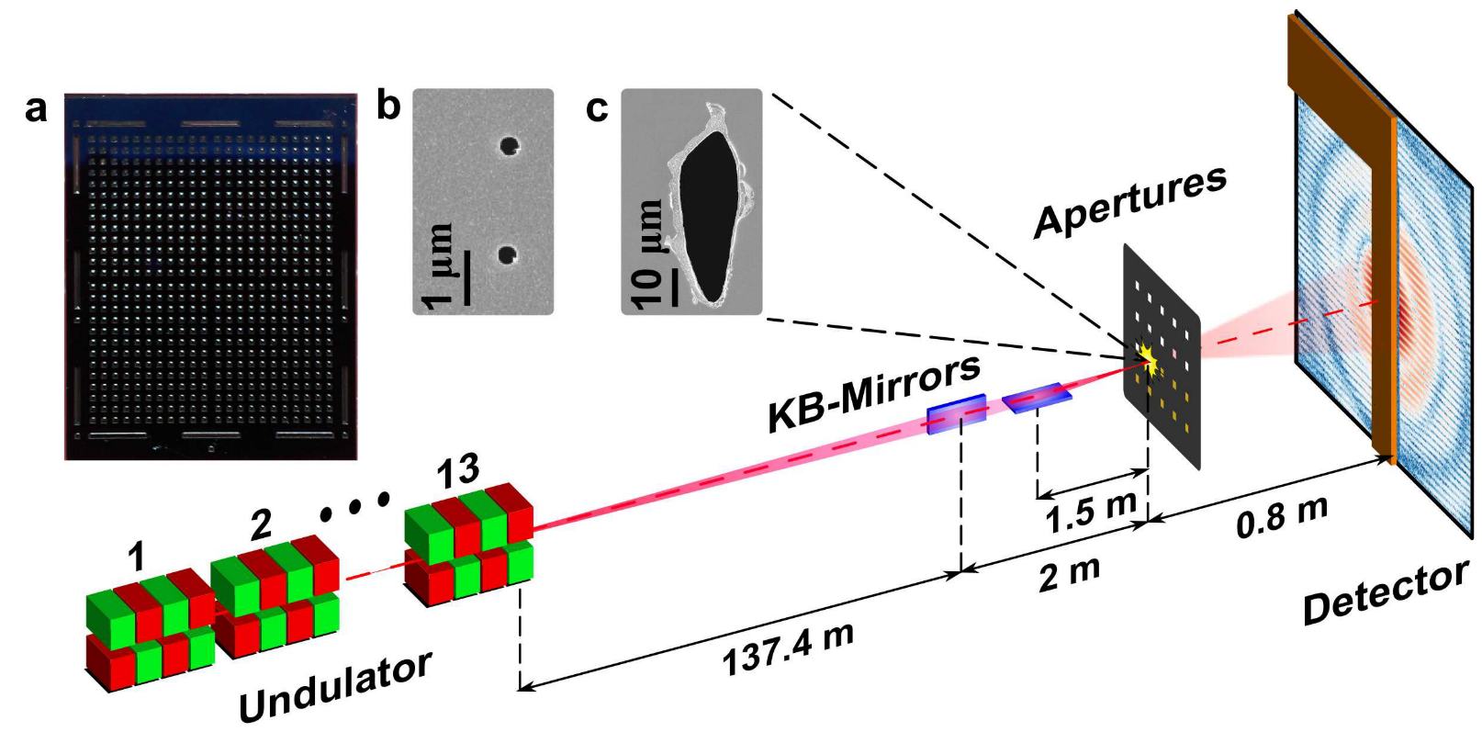
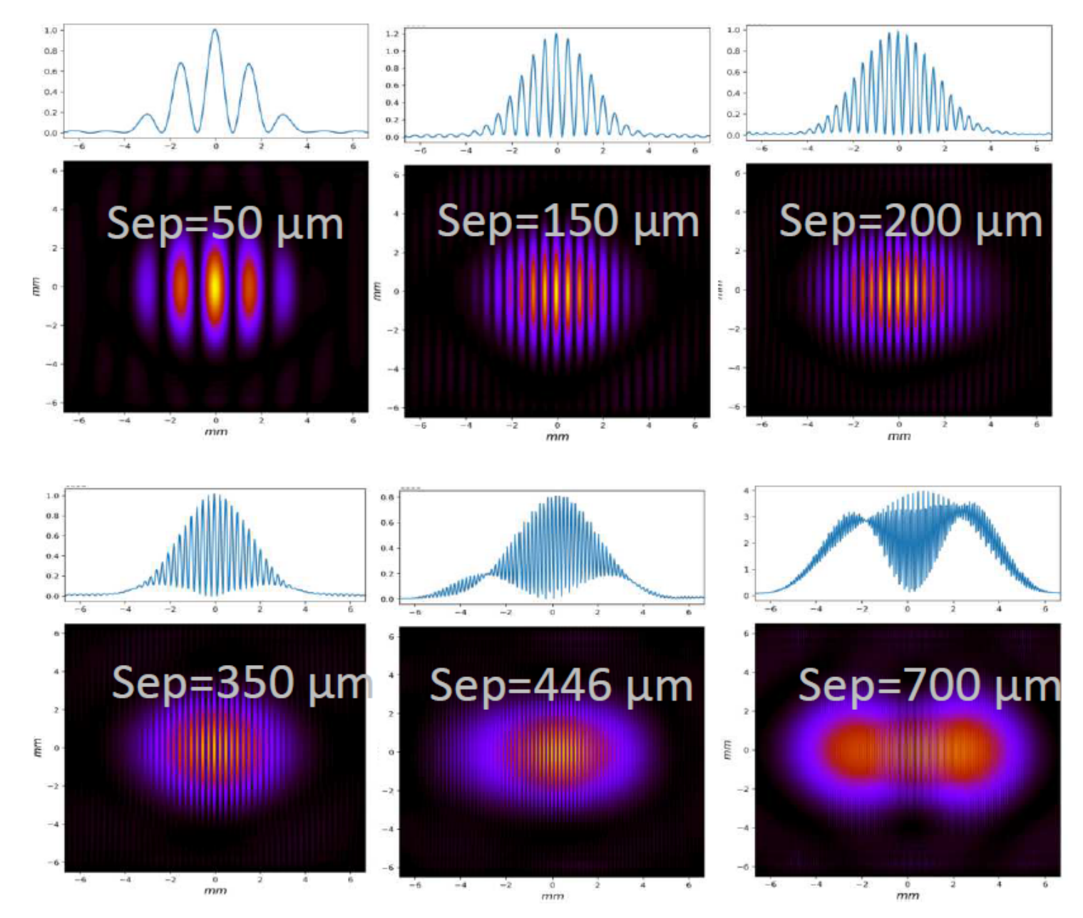
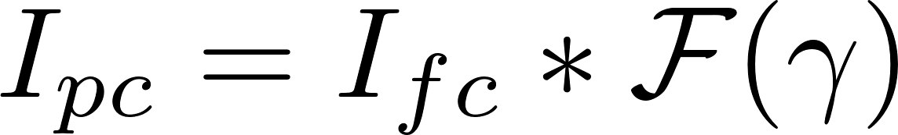
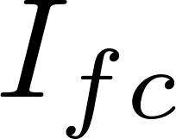
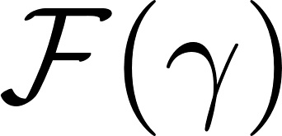
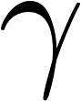

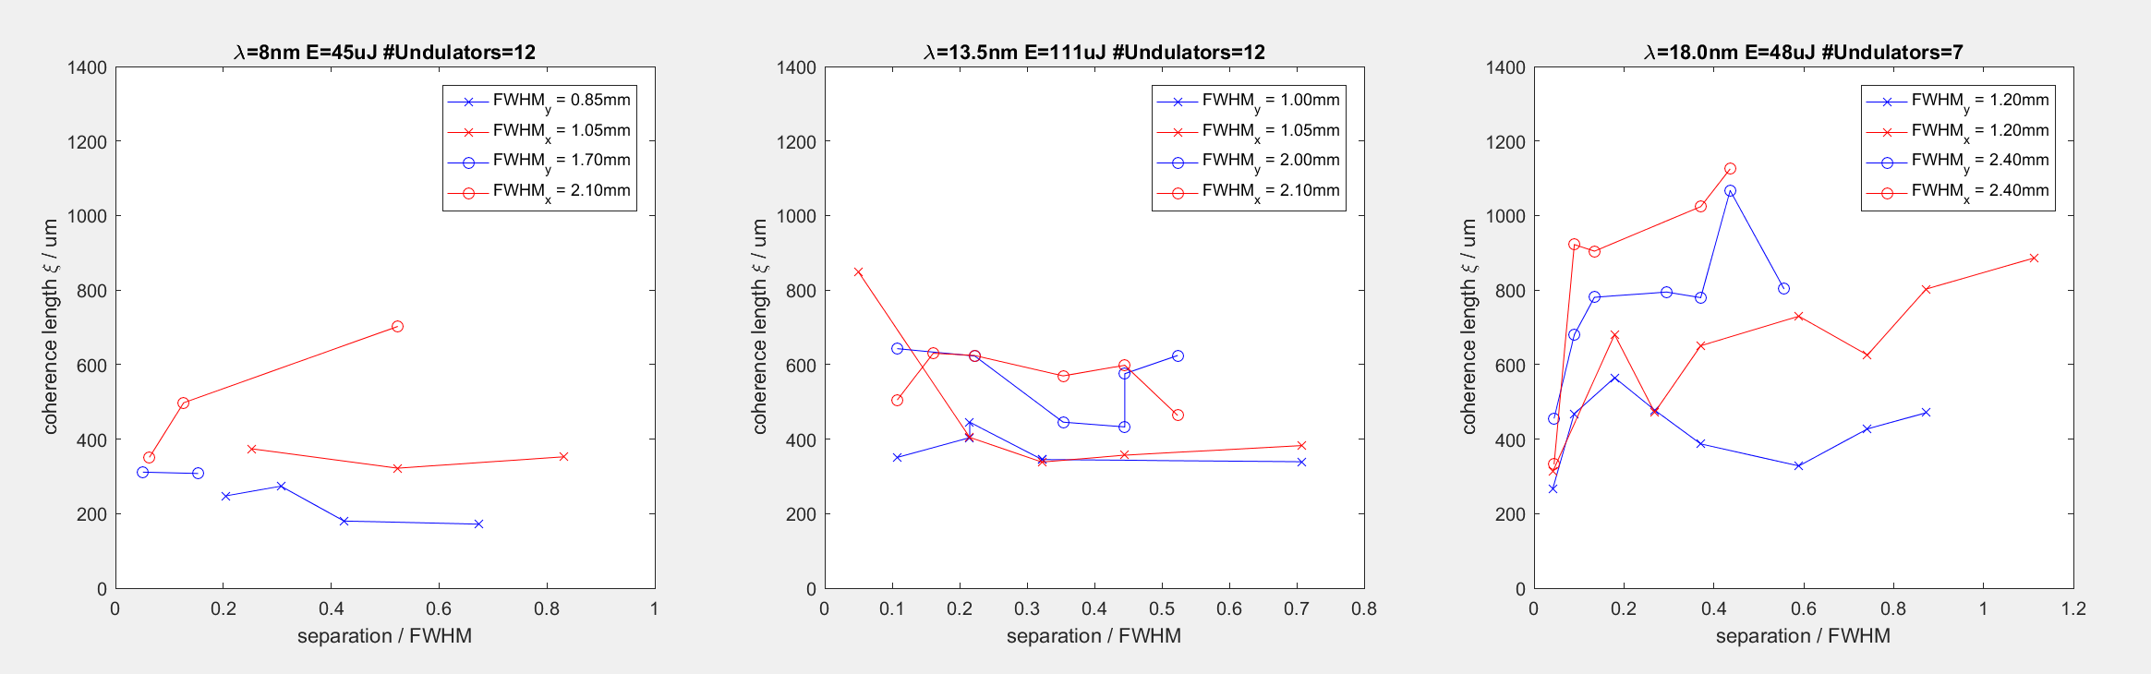
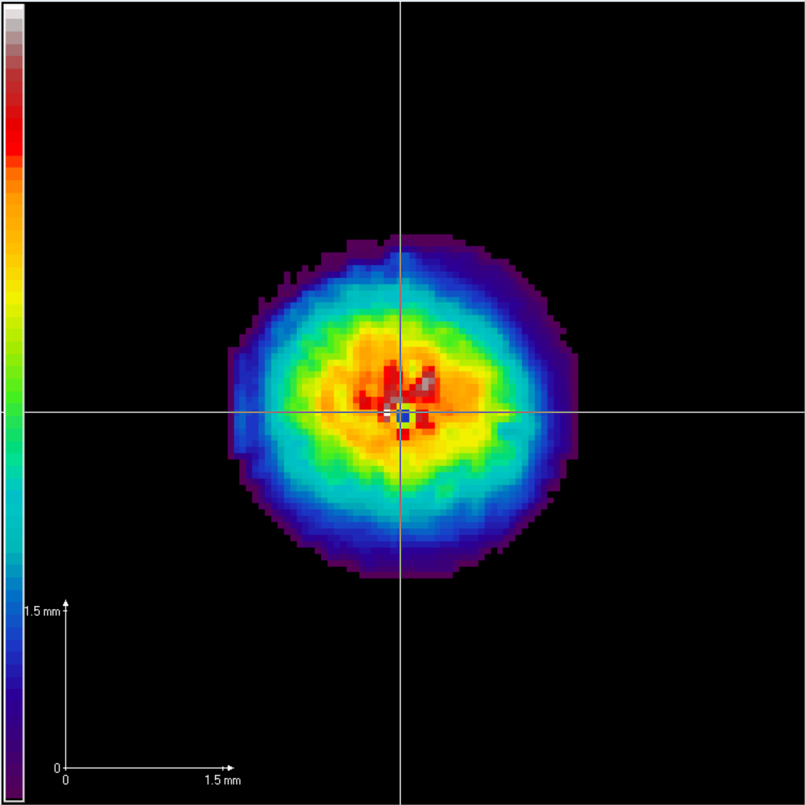
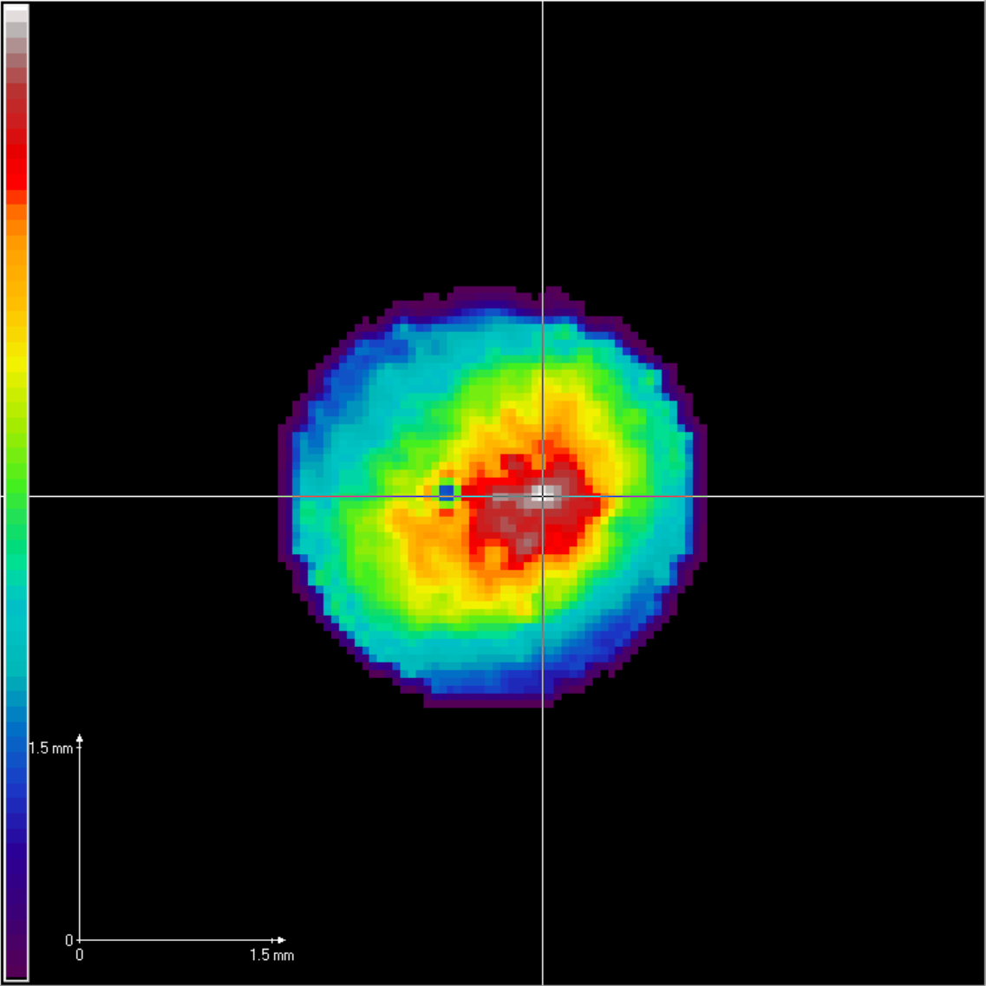
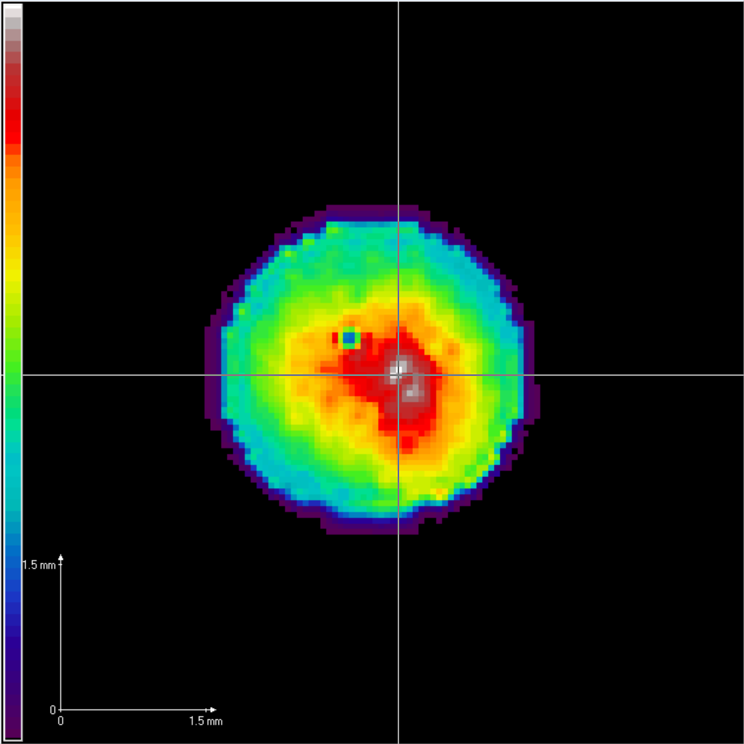


/ DESY
Coherence measurements with double pinholes at FLASH2
T. Wodzinski^{1,2}, M. Ruiz-Lopez^{2 ,} M. Mehrjoo², B. Keitel², M. Kuhlmann², M. Brachmanski², S. Künzel¹, M. Fajardo¹ and E. Plönjes-Palm²
thomas.wodzinski@tecnico.ulisboa.pt
¹Group of Lasers and Plasmas (GoLP)
Instituto de Plasmas e Fusão Nuclear (IPFN)
Instituto Superior Técnico Lisboa (IST)
²DESY, FLASH
Beamtime in Nov/Dez 2017 at FL24
Direct coherence measurements with double pinholes & slits
Wave front measurements
PMMA imprints (in collaboration with Chalupsky et al (FZU Prague) & Dziarzhytski (DESY)
Wavelengths 8.0nm, 13.5nm and 18.0nm and different undulator settings
Experimental Setup
KAOS: Variable micro-focus
KB focusing system using bendable mirrors
Kirkpatrick-Baez mirror optics
diff. pumping stage
+ WFS diagnostics
+ laser in-coupling
FEL
pre-mirror
In = focused
Out = unfocused
Exp
Double Pinholes
DESY wave front sensor
Pinholes of 10 um diameter
Pinholes-B: Variable beam size with KAOS
6 m from CCD
107 um to 1570 um separations
Measured beam position with fluorescent coating
Measured pinhole diameters and separations under microscope
3.1 µm * 3.3 µm FWHM focus at 8 nm
→ up to 5*10¹⁶ W/cm²
Collaboration of FLASH with M. Zandrando, L. Raimondi et al., Fermi@Elettra
Adjustable focus (nominal 2m behind first mirror)
Online analysis with DESY WFS (Backpropagation, Zernike Aberrations)
Bendable mirrors of 400 mm length with 2° grazing incidence
Simulation of interference in the intermediate zone
In a classical approach, the pinholes would be destroyed by being placed 1.5mm from the focussed beam (Singer 2013).
Here, the double-pinholes were positioned 1m behind the focus. This introduced a curvature to the beam, leading to a diffraction pattern in the intermediate zone instead of the far-field. Usually, one would determine the complex degree of coherence γ from the central visibility of the pattern.
The blind-deconvolution method (Clark 2012) can be used here to obtain the coherence length ξ.
Singer (2013)
The partially coherent interference pattern is the convolution of a fully coherent pattern with the Fourier-transform of the coherence function γ (Clark et al. 2012):
blind-deconvolution
The transverse coherence length ξ is the rms width of the coherence function γ:
rms width
Simulated intensity distribution from a double-pinhole experiment for different pinhole separations. A divergent beam illuminates the pinholes and the diffracted light propagates in the intermediate zone.
Coherence length vs. Pinhole Separation
Interference pattern example
8nm
13.5nm
18nm
FWHM=(2.1 x 1.7)mm
FWHM=(2.1 x 2.0)mm
FWHM=(2.4 x 2.4)mm
Measured partially coherent interference pattern (blue) with the reconstructed fully coherent pattern (red) after applying a blind deconvolution algorithm
Backpropagation to pinhole plate
This project has received funding from the European Union’s Horizon 2020 Research and Innovation programme under Grant Agreement No 730872.

Slide 2
Blind-deconvolution method for an interference pattern in the intermediate zone

